Slide 1
The Market Forces
of Supply and Demand
© 2015 Cengage Learning. All Rights Reserved. May not be copied, scanned, or duplicated, in whole or in part, except for use as permitted in a license distributed with a certain product or service or otherwise on a password-protected website for classroom use.

Slide 2
Markets and Competition
Supply and demand
  Words economists use most often
  The forces that make market economies work
  Refer to the behavior of people as they interact with one another in competitive markets
© 2015 Cengage Learning. All Rights Reserved. May not be copied, scanned, or duplicated, in whole or in part, except for use as permitted in a license distributed with a certain product or service or otherwise on a password-protected website for classroom use.

Slide 3
Markets and Competition
Market
  A group of buyers and sellers of a particular good or service
  Buyers as a group
    Determine the demand for the product
  Sellers as a group
    Determine the supply of the product
© 2015 Cengage Learning. All Rights Reserved. May not be copied, scanned, or duplicated, in whole or in part, except for use as permitted in a license distributed with a certain product or service or otherwise on a password-protected website for classroom use.

Slide 4
Markets and Competition
Markets take many forms
  Highly organized
    Markets for many agricultural commodities
  Less organized
    Market for ice cream in a particular town
© 2015 Cengage Learning. All Rights Reserved. May not be copied, scanned, or duplicated, in whole or in part, except for use as permitted in a license distributed with a certain product or service or otherwise on a password-protected website for classroom use.

Slide 5
Markets and Competition
Competitive market
  Market in which there are many buyers and many sellers
  Each has a negligible impact on market price
  Price and quantity are determined by all buyers and sellers
    As they interact in the marketplace
© 2015 Cengage Learning. All Rights Reserved. May not be copied, scanned, or duplicated, in whole or in part, except for use as permitted in a license distributed with a certain product or service or otherwise on a password-protected website for classroom use.

Slide 6
Markets and Competition
Perfectly competitive market
  Goods offered for sale are all exactly the same
  Buyers and sellers are so numerous
    No single buyer or seller has any influence over the market price
    Price takers
  At the market price
    Buyers can buy all they want
    Sellers can sell all they want
© 2015 Cengage Learning. All Rights Reserved. May not be copied, scanned, or duplicated, in whole or in part, except for use as permitted in a license distributed with a certain product or service or otherwise on a password-protected website for classroom use.

Slide 7
Markets and Competition
Monopoly
  The only seller in the market
  Sets the price
Other markets
  Between perfect competition and monopoly
© 2015 Cengage Learning. All Rights Reserved. May not be copied, scanned, or duplicated, in whole or in part, except for use as permitted in a license distributed with a certain product or service or otherwise on a password-protected website for classroom use.

Slide 8
Demand
Quantity demanded
  Amount of a good that buyers are willing and able to purchase
Law of demand
  Other things equal
  When the price of a good rises, the quantity demanded of the good falls
  When the price falls, the quantity demanded rises
© 2015 Cengage Learning. All Rights Reserved. May not be copied, scanned, or duplicated, in whole or in part, except for use as permitted in a license distributed with a certain product or service or otherwise on a password-protected website for classroom use.

Slide 9
Demand
Demand
  Relationship between the price of a good and quantity demanded
  Demand schedule: a table
  Demand curve: a graph
    Price on the vertical axis
    Quantity on the horizontal axis
Individual demand
  An individual’s demand for a product
© 2015 Cengage Learning. All Rights Reserved. May not be copied, scanned, or duplicated, in whole or in part, except for use as permitted in a license distributed with a certain product or service or otherwise on a password-protected website for classroom use.

Slide 10
Figure 1
Catherine’s Demand Schedule and Demand Curve
Price of Ice-Cream Cones
1. A decrease
in price . . .
Price of Ice-Cream Cone | Quantity of Cones Demanded
$0.00 0.50 1.00 1.50 2.00 2.50 3.00 | 12 cones 10 8 6 4 2 0
$3.00
2.50
2.00
2. . . . increases quantity
of cones demanded.
1.50
1.00
Demand curve
0.50
0
1
2
3
4
5
6
7
8
9
10
11
12
Quantity of Ice-Cream Cones
The demand schedule is a table that shows the quantity demanded at each price. The demand curve, which graphs the demand schedule, illustrates how the quantity demanded of the good changes as its price varies. Because a lower price increases the quantity demanded, the demand curve slopes downward.
© 2015 Cengage Learning. All Rights Reserved. May not be copied, scanned, or duplicated, in whole or in part, except for use as permitted in a license distributed with a certain product or service or otherwise on a password-protected website for classroom use.

Slide 11
Demand
Market demand
  Sum of all individual demands for a good or service
Market demand curve
  Sum the individual demand curves horizontally
  Total quantity demanded of a good varies
    As the price of the good varies
    Other things constant
© 2015 Cengage Learning. All Rights Reserved. May not be copied, scanned, or duplicated, in whole or in part, except for use as permitted in a license distributed with a certain product or service or otherwise on a password-protected website for classroom use.

Slide 12
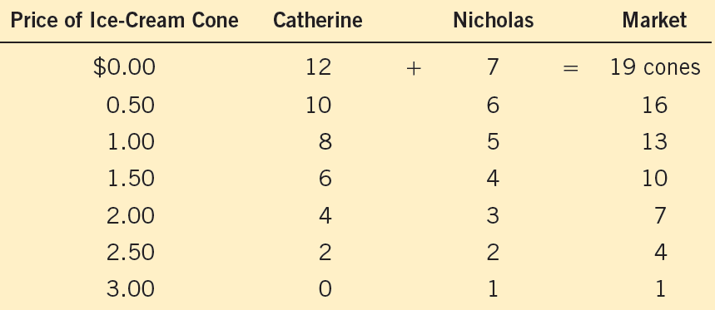
Figure 2
Market Demand as the Sum of Individual Demands
The quantity demanded in a market is the sum of the quantities demanded by all the buyers at each price. Thus, the market demand curve is found by adding horizontally the individual demand curves. At a price of $2.00, Catherine demands 4 ice-cream cones, and Nicholas demands 3 ice-cream cones. The quantity demanded in the market at this price is 7 cones.
© 2015 Cengage Learning. All Rights Reserved. May not be copied, scanned, or duplicated, in whole or in part, except for use as permitted in a license distributed with a certain product or service or otherwise on a password-protected website for classroom use.

Slide 13
Figure 2
Market Demand as the Sum of Individual Demands
+
=
Catherine’s demand
Nicholas’s demand
Market demand
Price of
Ice-Cream
Cones
Price of
Ice-Cream
Cones
Price of
Ice-Cream
Cones
$3.00
D_{Catherine}
$3.00
$3.00
D_{Nicholas}
2.50
2.50
2.50
2.00
2.00
2.00
1.50
1.50
1.50
D_{Market}
1.00
1.00
1.00
0.50
0.50
0.50
0
1
2
3
4
5
6
7
8
9
10
11
12
0
1
2
3
4
5
6
7
0
2
4
6
8
10
12
14
16
18
Quantity of Ice-Cream Cones
Quantity of Ice-Cream Cones
Quantity of Ice-Cream Cones
© 2015 Cengage Learning. All Rights Reserved. May not be copied, scanned, or duplicated, in whole or in part, except for use as permitted in a license distributed with a certain product or service or otherwise on a password-protected website for classroom use.

Slide 14
Demand
Shifts in the demand curve
  Increase in demand
    Any change that increases the quantity demanded at every price
    Demand curve shifts right
  Decrease in demand
    Any change that decreases the quantity demanded at every price
    Demand curve shifts left
© 2015 Cengage Learning. All Rights Reserved. May not be copied, scanned, or duplicated, in whole or in part, except for use as permitted in a license distributed with a certain product or service or otherwise on a password-protected website for classroom use.

Slide 15
Figure 3
Shifts in the Demand Curve
Price of
Ice-Cream
Cones
Increase in
Demand
Decrease in
Demand
Demand
curve, D₁
Demand
curve, D₂
Demand
curve, D₃
0
Quantity of Ice-Cream Cones
Any change that raises the quantity that buyers wish to purchase at any given price shifts the demand curve to the right. Any change that lowers the quantity that buyers wish to purchase at any given price shifts the demand curve to the left.
© 2015 Cengage Learning. All Rights Reserved. May not be copied, scanned, or duplicated, in whole or in part, except for use as permitted in a license distributed with a certain product or service or otherwise on a password-protected website for classroom use.

Slide 16
Demand
Variables that can shift the demand curve
  Income
  Prices of related goods
  Tastes
  Expectations
  Number of buyers
© 2015 Cengage Learning. All Rights Reserved. May not be copied, scanned, or duplicated, in whole or in part, except for use as permitted in a license distributed with a certain product or service or otherwise on a password-protected website for classroom use.

Slide 17
Demand
Income
  Normal good
    Other things constant
    An increase in income leads to an increase in demand
  Inferior good
    Other things constant
    An increase in income leads to a decrease in demand
© 2015 Cengage Learning. All Rights Reserved. May not be copied, scanned, or duplicated, in whole or in part, except for use as permitted in a license distributed with a certain product or service or otherwise on a password-protected website for classroom use.

Slide 18
Demand
Prices of related goods
  Substitutes, two goods
    An increase in the price of one
    Leads to an increase in the demand for the other
  Complements, two goods
    An increase in the price of one
    Leads to a decrease in the demand for the other
© 2015 Cengage Learning. All Rights Reserved. May not be copied, scanned, or duplicated, in whole or in part, except for use as permitted in a license distributed with a certain product or service or otherwise on a password-protected website for classroom use.

Slide 19
Demand
Tastes
  Change in tastes: changes the demand
Expectations about the future
  Expect an increase in income
    Increase in current demand
  Expect higher prices
    Increase in current demand
Number of buyers, increases
  Market demand increases
© 2015 Cengage Learning. All Rights Reserved. May not be copied, scanned, or duplicated, in whole or in part, except for use as permitted in a license distributed with a certain product or service or otherwise on a password-protected website for classroom use.

Slide 20
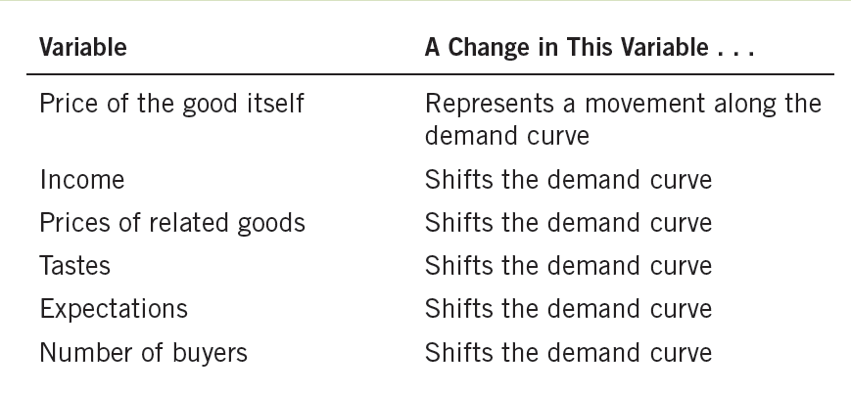
Table 1
Variables That Influence Buyers
This table lists the variables that affect how much consumers choose to buy of any good. Notice the special role that the price of the good plays: A change in the good’s price represents a movement along the demand curve, whereas a change in one of the other variables shifts the demand curve.
© 2015 Cengage Learning. All Rights Reserved. May not be copied, scanned, or duplicated, in whole or in part, except for use as permitted in a license distributed with a certain product or service or otherwise on a password-protected website for classroom use.

Slide 21

Two ways to reduce the quantity of smoking demanded
“What is the best way to
stop this?”
Shift the demand curve for cigarettes and other tobacco products
Try to raise the price of cigarettes
© 2015 Cengage Learning. All Rights Reserved. May not be copied, scanned, or duplicated, in whole or in part, except for use as permitted in a license distributed with a certain product or service or otherwise on a password-protected website for classroom use.

Slide 22
Two ways to reduce the quantity of smoking demanded
Shift the demand curve for cigarettes and other tobacco products
  Public service announcements
  Mandatory health warnings on cigarette packages
  Prohibition of cigarette advertising on television
If successful
  Shift demand curve to the left
© 2015 Cengage Learning. All Rights Reserved. May not be copied, scanned, or duplicated, in whole or in part, except for use as permitted in a license distributed with a certain product or service or otherwise on a password-protected website for classroom use.

Slide 23
Two ways to reduce the quantity of smoking demanded
Try to raise the price of cigarettes
  Tax the manufacturer: higher price
  Movement along demand curve
    10% ↑ in price → 4% ↓ in smoking
    Teenagers: 10% ↑ in price → 12% ↓ in smoking
Demand for cigarettes vs. demand for marijuana
  Appear to be complements
© 2015 Cengage Learning. All Rights Reserved. May not be copied, scanned, or duplicated, in whole or in part, except for use as permitted in a license distributed with a certain product or service or otherwise on a password-protected website for classroom use.

Slide 24
Figure 4
Shifts in the Demand Curve versus Movements along the Demand Curve
(a) A Shift in the Demand Curve
(b) A Movement along the Demand Curve
Price of Cigarettes, per Pack
Price of Cigarettes, per Pack
A policy to discourage smoking shifts the demand curve to the left
A tax that raises the price of cigarettes results in a movement along the demand curve
$4.00
C
B
A
$2.00
2.00
A
D₁
D₂
D₁
0
10
20
0
12
20
Number of Cigarettes Smoked per Day
Number of Cigarettes Smoked per Day
If warnings on cigarette packages convince smokers to smoke less, the demand curve for cigarettes shifts to the left. In panel (a), the demand curve shifts from D₁ to D₂. At a price of $2.00 per pack, the quantity demanded falls from 20 to 10 cigarettes per day, as reflected by the shift from point A to point B. By contrast, if a tax raises the price of cigarettes, the demand curve does not shift. Instead, we observe a movement to a different point on the demand curve. In panel (b), when the price rises from $2.00 to $4.00, the quantity demanded falls from 20 to 12 cigarettes per day, as reflected by the movement from point A to point C.
© 2015 Cengage Learning. All Rights Reserved. May not be copied, scanned, or duplicated, in whole or in part, except for use as permitted in a license distributed with a certain product or service or otherwise on a password-protected website for classroom use.

Slide 25
Supply
Quantity supplied
  Amount of a good
  Sellers are willing and able to sell
Law of supply
  Other things equal
  When the price of a good rises, the quantity supplied of the good also rises
  When the price falls, the quantity supplied falls as well
© 2015 Cengage Learning. All Rights Reserved. May not be copied, scanned, or duplicated, in whole or in part, except for use as permitted in a license distributed with a certain product or service or otherwise on a password-protected website for classroom use.

Slide 26
Supply
Supply
  Relationship between the price of a good and the quantity supplied
  Supply schedule: a table
  Supply curve: a graph
    Price on the vertical axis
    Quantity on the horizontal axis
Individual supply
  A seller’s individual supply
© 2015 Cengage Learning. All Rights Reserved. May not be copied, scanned, or duplicated, in whole or in part, except for use as permitted in a license distributed with a certain product or service or otherwise on a password-protected website for classroom use.

Slide 27
Figure 5
Ben’s Supply Schedule and Supply Curve
Price of Ice-Cream Cones
Supply curve
Price of Ice-cream Cone | Quantity Of Cones Supplied
$0.00 0.50 1.00 1.50 2.00 2.50 3.00 | 0 cones 0 1 2 3 4 5
$3.00
1. An increase
in price . . .
2.50
2.00
1.50
2. . . . increases quantity of cones supplied.
1.00
0.50
0
1
2
3
4
5
6
7
8
9
10
11
12
Quantity of Ice-Cream Cones
The supply schedule is a table that shows the quantity supplied at each price. This supply curve, which graphs the supply schedule, illustrates how the quantity supplied of the good changes as its price varies. Because a higher price increases the quantity supplied, the supply curve slopes upward.
© 2015 Cengage Learning. All Rights Reserved. May not be copied, scanned, or duplicated, in whole or in part, except for use as permitted in a license distributed with a certain product or service or otherwise on a password-protected website for classroom use.

Slide 28
Supply
Market supply
  Sum of the supplies of all sellers for a good or service
Market supply curve
  Sum of individual supply curves horizontally
  Total quantity supplied of a good varies
    As the price of the good varies
    All other factors that affect how much suppliers want to sell are hold constant
© 2015 Cengage Learning. All Rights Reserved. May not be copied, scanned, or duplicated, in whole or in part, except for use as permitted in a license distributed with a certain product or service or otherwise on a password-protected website for classroom use.

Slide 29
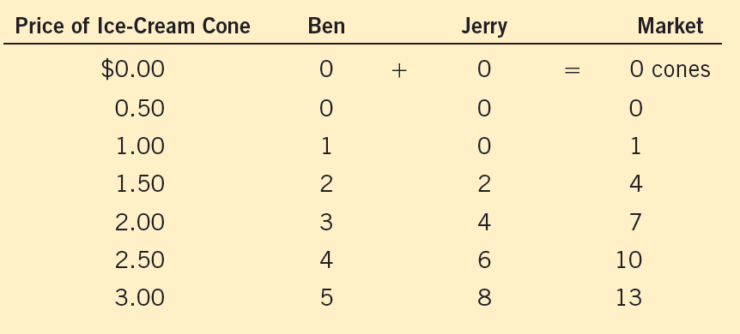
Figure 6
Market Supply as the Sum of Individual Supplies
The quantity supplied in a market is the sum of the quantities supplied by all the sellers at each price. Thus, the market supply curve is found by adding horizontally the individual supply curves. At a price of $2.00, Ben supplies 3 ice-cream cones, and Jerry supplies 4 ice-cream cones. The quantity supplied in the market at this price is 7 cones.
© 2015 Cengage Learning. All Rights Reserved. May not be copied, scanned, or duplicated, in whole or in part, except for use as permitted in a license distributed with a certain product or service or otherwise on a password-protected website for classroom use.

Slide 30
Figure 6
Market Supply as the Sum of Individual Supplies
+
=
Ben’s supply
Jerry’s supply
Market supply
Price of
Ice-Cream
Cones
Price of
Ice-Cream
Cones
Price of
Ice-Cream
Cones
S_{Ben}
$3.00
$3.00
S_{Market}
S_{Jerry}
$3.00
2.50
2.50
2.50
2.00
2.00
2.00
1.50
1.50
1.50
1.00
1.00
1.00
0.50
0.50
0.50
0
1
2
3
4
5
6
7
0
1
2
3
4
5
6
7
0
2
4
6
8
10
12
14
16
18
Quantity of
Ice-Cream Cones
Quantity of
Ice-Cream Cones
Quantity of
Ice-Cream Cones
© 2015 Cengage Learning. All Rights Reserved. May not be copied, scanned, or duplicated, in whole or in part, except for use as permitted in a license distributed with a certain product or service or otherwise on a password-protected website for classroom use.

Slide 31
Supply
Shifts in supply
  Increase in supply
    Any change that increases the quantity supplied at every price
    Supply curve shifts right
  Decrease in supply
    Any change that decreases the quantity supplied at every price
    Supply curve shifts left
© 2015 Cengage Learning. All Rights Reserved. May not be copied, scanned, or duplicated, in whole or in part, except for use as permitted in a license distributed with a certain product or service or otherwise on a password-protected website for classroom use.

Slide 32
Exhibit 7
Shifts in the Supply Curve
Price of
Ice-Cream
Cones
Supply
curve, S₃
Supply
curve, S₁
Supply
curve, S₂
Decrease
In supply
Increase in
Supply
0
Quantity of Ice-Cream Cones
Any change that raises the quantity that sellers wish to produce at any given price shifts the supply curve to the right. Any change that lowers the quantity that sellers wish to produce at any given price shifts the supply curve to the left.
© 2015 Cengage Learning. All Rights Reserved. May not be copied, scanned, or duplicated, in whole or in part, except for use as permitted in a license distributed with a certain product or service or otherwise on a password-protected website for classroom use.

Slide 33
Supply
Variables that can shift the supply curve
  Input prices
  Technology
  Expectations about future
  Number of sellers
© 2015 Cengage Learning. All Rights Reserved. May not be copied, scanned, or duplicated, in whole or in part, except for use as permitted in a license distributed with a certain product or service or otherwise on a password-protected website for classroom use.

Slide 34
Supply
Input prices
  Supply is negatively related to prices of inputs
  Higher input prices: decrease in supply
Technology
  Advance in technology: increase in supply
© 2015 Cengage Learning. All Rights Reserved. May not be copied, scanned, or duplicated, in whole or in part, except for use as permitted in a license distributed with a certain product or service or otherwise on a password-protected website for classroom use.

Slide 35
Supply
Expectations about future
  Affect current supply
  Expected higher prices
    Decrease in current supply
Number of sellers, increases
  Market supply increases
© 2015 Cengage Learning. All Rights Reserved. May not be copied, scanned, or duplicated, in whole or in part, except for use as permitted in a license distributed with a certain product or service or otherwise on a password-protected website for classroom use.

Slide 36
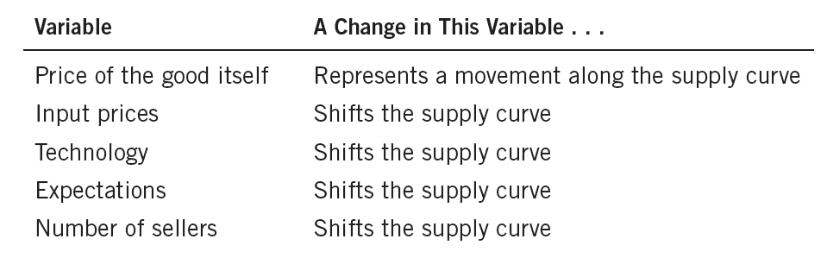
Table 2
Variables That Influence Sellers
This table lists the variables that affect how much producers choose to sell of any good. Notice the special role that the price of the good plays: A change in the good’s price represents a movement along the supply curve, whereas a change in one of the other variables shifts the supply curve.
© 2015 Cengage Learning. All Rights Reserved. May not be copied, scanned, or duplicated, in whole or in part, except for use as permitted in a license distributed with a certain product or service or otherwise on a password-protected website for classroom use.

Slide 37
Supply and Demand Together
Equilibrium
  Various forces are in balance
  A situation in which market price has reached the level where
    Quantity supplied = quantity demanded
  Supply and demand curves intersect
© 2015 Cengage Learning. All Rights Reserved. May not be copied, scanned, or duplicated, in whole or in part, except for use as permitted in a license distributed with a certain product or service or otherwise on a password-protected website for classroom use.

Slide 38
Supply and Demand Together
Equilibrium price
  Balances quantity supplied and quantity demanded
  Market-clearing price
Equilibrium quantity
  Quantity supplied and quantity demanded at the equilibrium price
© 2015 Cengage Learning. All Rights Reserved. May not be copied, scanned, or duplicated, in whole or in part, except for use as permitted in a license distributed with a certain product or service or otherwise on a password-protected website for classroom use.

Slide 39
Figure 8
The Equilibrium of Supply and Demand
Price of
Ice-Cream
Cones
Equilibrium
Supply
$3.00
2.50
Equilibrium
price
2.00
Equilibrium
quantity
1.50
1.00
Demand
0.50
0
1
2
3
4
5
6
7
8
9
10
11
12
Quantity of Ice-Cream Cones
The equilibrium is found where the supply and demand curves intersect. At the equilibrium price, the quantity supplied equals the quantity demanded. Here the equilibrium price is $2.00: At this price, 7 ice-cream cones are supplied, and 7 ice-cream cones are demanded.
© 2015 Cengage Learning. All Rights Reserved. May not be copied, scanned, or duplicated, in whole or in part, except for use as permitted in a license distributed with a certain product or service or otherwise on a password-protected website for classroom use.

Slide 40
Supply and Demand Together
Surplus
  Quantity supplied > quantity demanded
  Excess supply
  Downward pressure on price
    Movements along the demand and supply curves
    Increase in quantity demanded
    Decrease in quantity supplied
© 2015 Cengage Learning. All Rights Reserved. May not be copied, scanned, or duplicated, in whole or in part, except for use as permitted in a license distributed with a certain product or service or otherwise on a password-protected website for classroom use.

Slide 41
Supply and Demand Together
Shortage
  Quantity demanded > quantity supplied
  Excess demand
  Upward pressure on price
    Movements along the demand and supply curves
    Decrease in quantity demanded
    Increase in quantity supplied
© 2015 Cengage Learning. All Rights Reserved. May not be copied, scanned, or duplicated, in whole or in part, except for use as permitted in a license distributed with a certain product or service or otherwise on a password-protected website for classroom use.

Slide 42
Figure 9
Markets Not in Equilibrium
Price of
Ice-Cream
Cones
(a) Excess Supply
Price of
Ice-Cream
Cones
(b) Excess demand
Surplus
Supply
Supply
$2.50
2.00
$2.00
Demand
1.50
Demand
Shortage
Quantity
demanded
Quantity
supplied
Quantity
supplied
Quantity
demanded
0
4
7
10
0
4
7
10
Quantity of Ice-Cream Cones
Quantity of Ice-Cream Cones
In panel (a), there is a surplus. Because the market price of $2.50 is above the equilibrium price, the quantity supplied (10 cones) exceeds the quantity demanded (4 cones). Suppliers try to increase sales by cutting the price of a cone, and this moves the price toward its equilibrium level. In panel (b), there is a shortage. Because the market price of $1.50 is below the equilibrium price, the quantity demanded (10 cones) exceeds the quantity supplied (4 cones). With too many buyers chasing too few goods, suppliers can take advantage of the shortage by raising the price. Hence, in both cases, the price adjustment moves the market toward the equilibrium of supply and demand
© 2015 Cengage Learning. All Rights Reserved. May not be copied, scanned, or duplicated, in whole or in part, except for use as permitted in a license distributed with a certain product or service or otherwise on a password-protected website for classroom use.

Slide 43
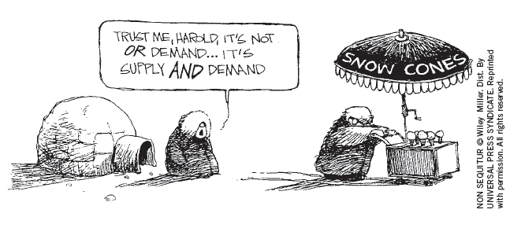
Supply and Demand Together
Law of supply and demand
  The price of any good adjusts
    To bring the quantity supplied and the quantity demanded for that good into balance
  In most markets
    Surpluses and shortages are temporary
© 2015 Cengage Learning. All Rights Reserved. May not be copied, scanned, or duplicated, in whole or in part, except for use as permitted in a license distributed with a certain product or service or otherwise on a password-protected website for classroom use.

Slide 44
Supply and Demand Together
Three steps to analyzing changes in equilibrium
  Decide whether the event shifts the supply curve, the demand curve, or, in some cases, both curves
  Decide whether the curve shifts to the right or to the left
  Use the supply-and-demand diagram
    Compare the initial and the new equilibrium
    Effects on equilibrium price and quantity
© 2015 Cengage Learning. All Rights Reserved. May not be copied, scanned, or duplicated, in whole or in part, except for use as permitted in a license distributed with a certain product or service or otherwise on a password-protected website for classroom use.

Slide 45
Table 3
Three Steps for Analyzing Changes in Equilibrium
Decide whether the event shifts the supply or demand curve (or perhaps both). 2. Decide in which direction the curve shifts. 3. Use the supply-and demand diagram to see how the shift changes the equilibrium price and quantity.
© 2015 Cengage Learning. All Rights Reserved. May not be copied, scanned, or duplicated, in whole or in part, except for use as permitted in a license distributed with a certain product or service or otherwise on a password-protected website for classroom use.

Slide 46
Supply and Demand Together
A change in market equilibrium due to a shift in demand
  One summer, very hot weather
  Effect on the market for ice cream?
  Hot weather: shifts the demand curve (tastes )
  Demand curve shifts to the right
  Higher equilibrium price; higher equilibrium quantity
© 2015 Cengage Learning. All Rights Reserved. May not be copied, scanned, or duplicated, in whole or in part, except for use as permitted in a license distributed with a certain product or service or otherwise on a password-protected website for classroom use.

Slide 47
Figure 10
How an increase in demand affects the equilibrium
Price of
Ice-Cream
Cones
1. Hot weather increases the demand for ice cream . . .
Supply
2. …resulting in
a higher price . . .
$2.50
New equilibrium
Initial equilibrium
2.00
3. …and a higher
quantity sold.
D₁
D₂
0
7
10
Quantity of Ice-Cream Cones
An event that raises quantity demanded at any given price shifts the demand curve to the right. The equilibrium price and the equilibrium quantity both rise. Here an abnormally hot summer causes buyers to demand more ice cream. The demand curve shifts from D₁ to D₂, which causes the equilibrium price to rise from $2.00 to $2.50 and the equilibrium quantity to rise from 7 to 10 cones.
© 2015 Cengage Learning. All Rights Reserved. May not be copied, scanned, or duplicated, in whole or in part, except for use as permitted in a license distributed with a certain product or service or otherwise on a password-protected website for classroom use.

Slide 48
Supply and Demand Together
Shifts vs. movements along curves
  Shift in the supply curve
    Change in supply
  Movement along a fixed supply curve
    Change in the quantity supplied
  Shift in the demand curve
    Change in demand
  Movement along a fixed demand curve
    Change in the quantity demanded
© 2015 Cengage Learning. All Rights Reserved. May not be copied, scanned, or duplicated, in whole or in part, except for use as permitted in a license distributed with a certain product or service or otherwise on a password-protected website for classroom use.

Slide 49
Supply and Demand Together
A change in market equilibrium due to a shift in supply
  One summer, a hurricane destroys part of the sugarcane crop: higher price of sugar
  Effect on the market for ice cream?
  Change in price of sugar: supply curve
  Supply curve: shifts to the left
  Higher equilibrium price; lower equilibrium quantity
© 2015 Cengage Learning. All Rights Reserved. May not be copied, scanned, or duplicated, in whole or in part, except for use as permitted in a license distributed with a certain product or service or otherwise on a password-protected website for classroom use.

Slide 50
Figure 11
How a Decrease in Supply Affects the Equilibrium
Price of
Ice-Cream
Cones
1. An increase in the price of sugar reduces
the supply of ice cream . . .
New equilibrium
S₂
2. …resulting in
a higher price . . .
S₁
$2.50
2.00
Initial equilibrium
3. …and a lower
quantity sold.
Demand
0
4
7
Quantity of Ice-Cream Cones
An event that reduces quantity supplied at any given price shifts the supply curve to the left. The equilibrium price rises, and the equilibrium quantity falls. Here an increase in the price of sugar (an input) causes sellers to supply less ice cream. The supply curve shifts from S₁ to S₂, which causes the equilibrium price of ice cream to rise from $2.00 to $2.50 and the equilibrium quantity to fall from 7 to 4 cones.
© 2015 Cengage Learning. All Rights Reserved. May not be copied, scanned, or duplicated, in whole or in part, except for use as permitted in a license distributed with a certain product or service or otherwise on a password-protected website for classroom use.

Slide 51
Supply and Demand Together
Shifts in both supply and demand
  One summer: hurricane and heat wave
    Heat wave shifts the demand curve; hurricane shifts the supply curve
    Demand curve shifts to the right; Supply curve shifts to the left
    Equilibrium price raises
      If demand increases substantially while supply falls just a little: equilibrium quantity rises
      If supply falls substantially while demand rises just a little: equilibrium quantity falls
© 2015 Cengage Learning. All Rights Reserved. May not be copied, scanned, or duplicated, in whole or in part, except for use as permitted in a license distributed with a certain product or service or otherwise on a password-protected website for classroom use.

Slide 52
Figure 12
A Shift in Both Supply and Demand
(a) Price Rises, Quantity Rises
(b) Price Rises, Quantity Falls
Price of
Ice-Cream
Cones
Price of
Ice-Cream
Cones
New
equilibrium
New
equilibrium
Large decrease
in supply
Large increase
in demand
S₂
D₂
S₂
S₁
D₁
S₁
P₂
P₂
P₁
D₂
P₁
Initial equilibrium
Small decrease
in supply
Initial
equilibrium
Small increase
in demand
D₁
0
Q₁
Q₂
0
Q₂
Q₁
Quantity of Ice-Cream Cones
Quantity of Ice-Cream Cones
Here we observe a simultaneous increase in demand and decrease in supply. Two outcomes are possible. In panel (a), the equilibrium price rises from P₁ to P₂, and the equilibrium quantity rises from Q₁ to Q₂. In panel (b), the equilibrium price again rises from P₁ to P₂, but the equilibrium quantity falls from Q₁ to Q₂.
© 2015 Cengage Learning. All Rights Reserved. May not be copied, scanned, or duplicated, in whole or in part, except for use as permitted in a license distributed with a certain product or service or otherwise on a password-protected website for classroom use.

Slide 53
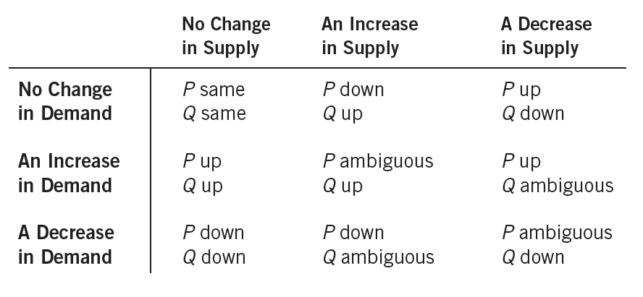
Table 4
What Happens to Price and Quantity When Supply
or Demand Shifts?
As a quick quiz, make sure you can explain at least a few of the entries in this table using a supply-and-demand diagram.
© 2015 Cengage Learning. All Rights Reserved. May not be copied, scanned, or duplicated, in whole or in part, except for use as permitted in a license distributed with a certain product or service or otherwise on a password-protected website for classroom use.

Slide 54

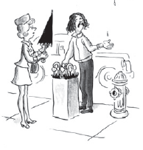
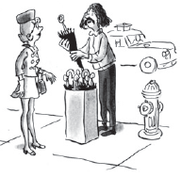
How Prices Allocate Resources
Supply and demand together
  Determine the prices of the economy’s many different goods and services
“Two dollars”
“—and seventy-five
cents.”
© 2015 Cengage Learning. All Rights Reserved. May not be copied, scanned, or duplicated, in whole or in part, except for use as permitted in a license distributed with a certain product or service or otherwise on a password-protected website for classroom use.

Slide 55
How Prices Allocate Resources
Prices
  Signals that guide the allocation of resources
  Mechanism for rationing scarce resources
  Determine who produces each good and how much is produced
© 2015 Cengage Learning. All Rights Reserved. May not be copied, scanned, or duplicated, in whole or in part, except for use as permitted in a license distributed with a certain product or service or otherwise on a password-protected website for classroom use.

